Slide 1
Process and its States

Slide 2
Process
A program in execution is called process. A process is more than the set of instructions, besides it contains memory area, local, global variable, CPU registers, Program Counters.
Process is an active entity that requires a set of resources, including a processors, program counters, registers, registers to perform its functions. Multiple process may associate with one program

Slide 3
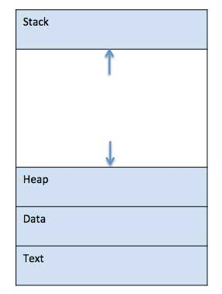
Component of Computer System
When a program is loaded into the memory and it becomes a process, it can be divided into four sections ─ stack, heap, text and data.

Slide 4
Types of Processes
CPU Bound Process: If the process is intensive in terms of CPU operations then it is called CPU bound process.
I/O Bound Process: If the process is intensive in terms of I/O operations then it is called IO bound process.

Slide 5
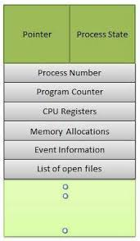
Process Control Block (PCB)
Each process is represented in the OS by a PROCESS CONTROL BLOCK (PCB)- also called Task control Block.

Slide 6
Concept of Multiprogramming
Pre-emption – Process is forcefully removed from CPU. Pre-emption is also called as time sharing or multitasking.
Non pre-emption – Processes are not removed until they complete the execution.

Slide 7
Schedulers
Schedulers are special system software which handles process scheduling in various ways. Their main task is to select the jobs to be submitted into the system and to decide which process to run. Schedulers are of three types −
Long-Term Scheduler
Short-Term Scheduler
Medium-Term Scheduler

Slide 8
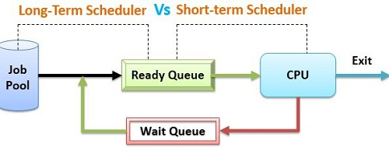
Long-Term Vs Short Term Scheduler

Slide 9
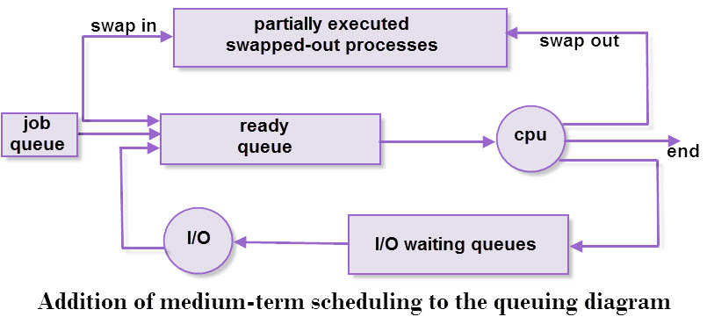
Medium Term Scheduler

Slide 10

Process State Diagram (5-States)
Awake ( Process-name) : New -> Ready
Dispatch ( Process-name): ready -> running
Timerrunout ( Process-name): running -> ready
Block( Process-name): running -> blocked
wakeup( Process-name): blocked-> ready

Slide 11
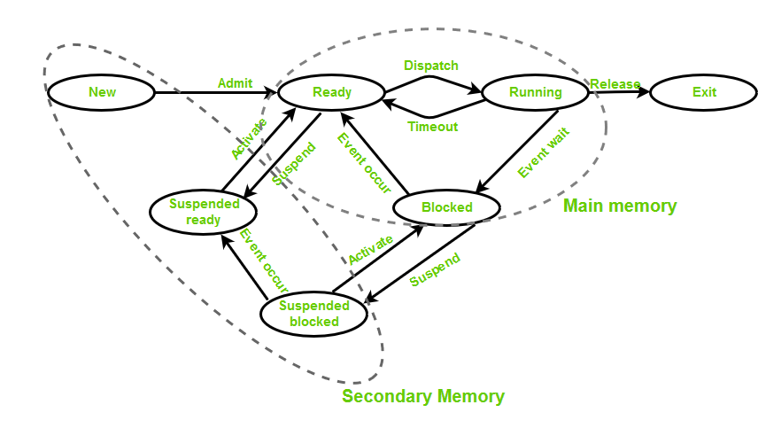
Process State Diagram ( 7 States)

Slide 12


